Slide 1
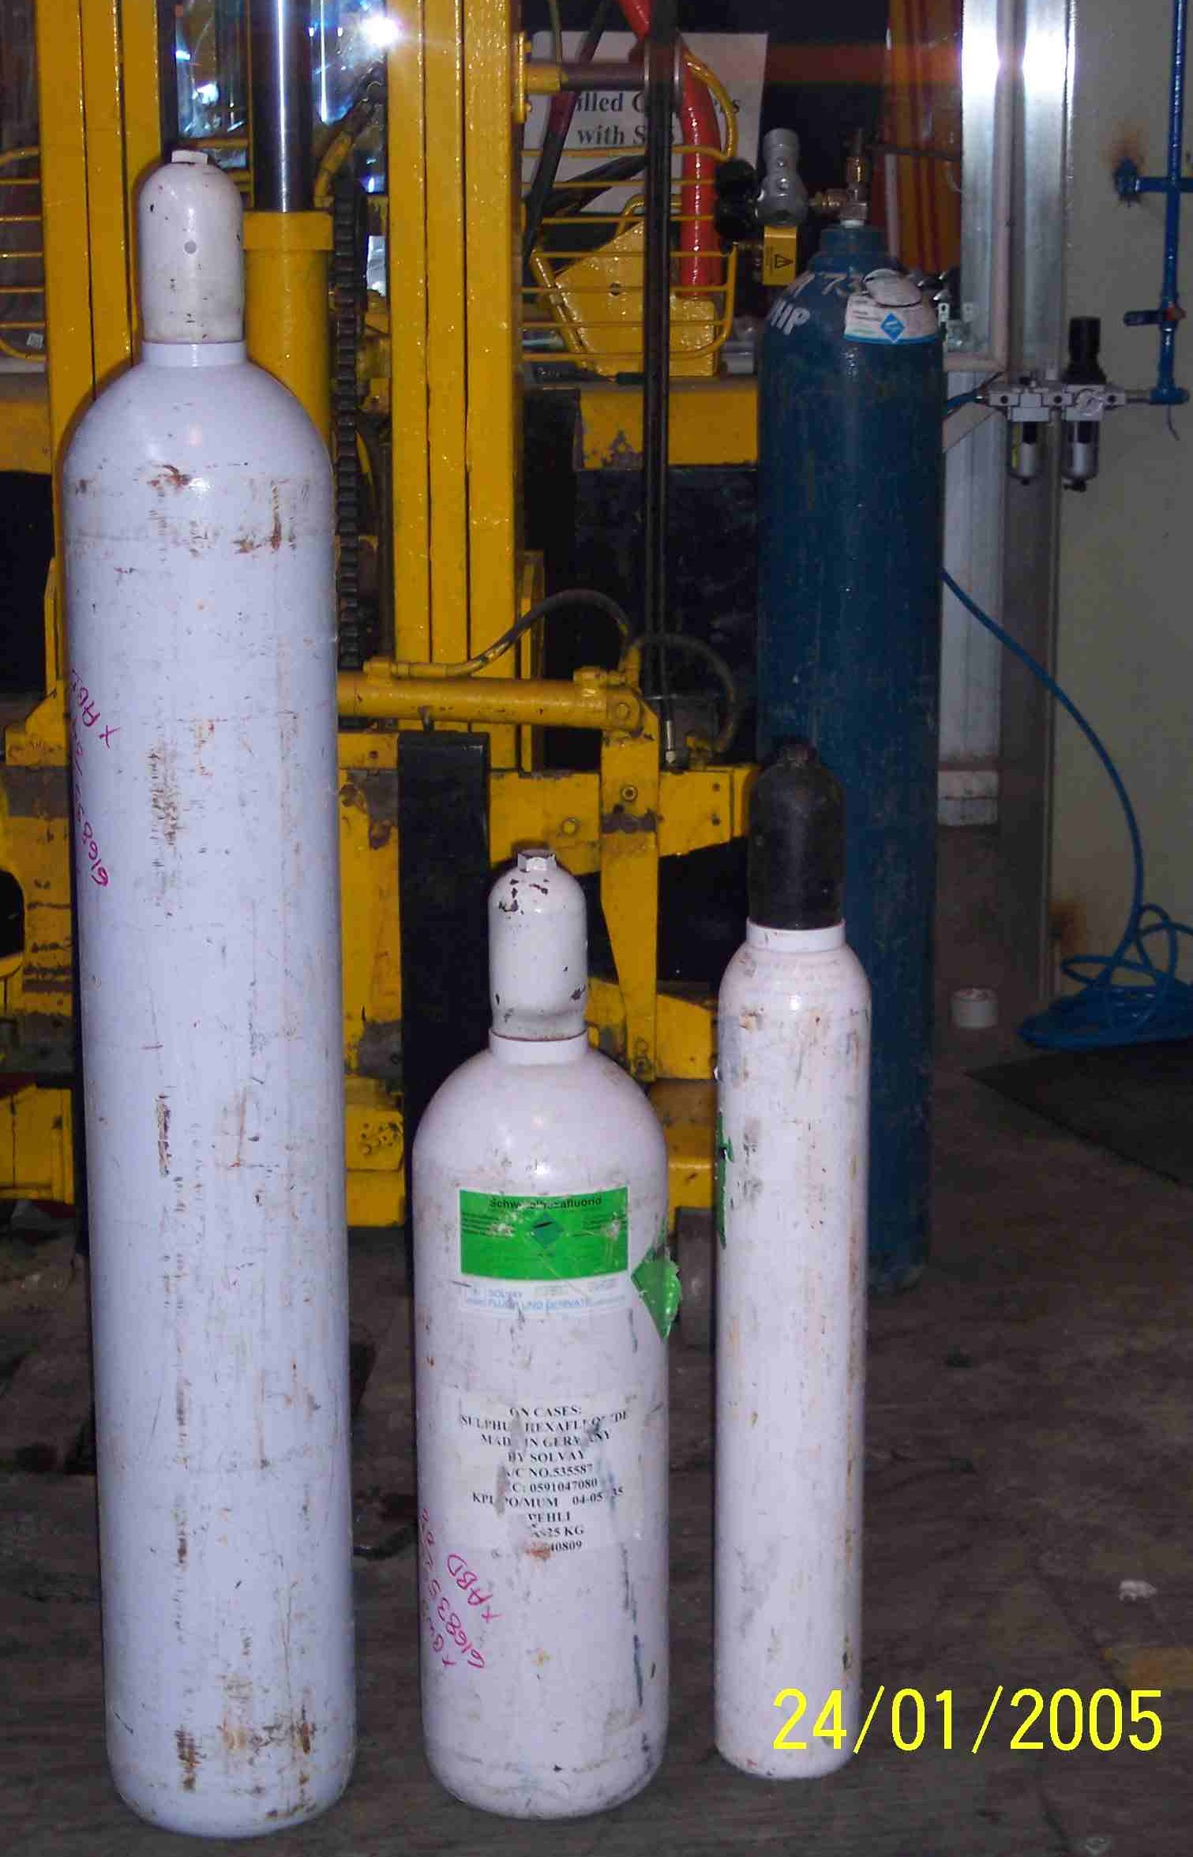
SIEMENS
HVCB SPARES
50Kg, S4799121701
25Kg, S4799191701
9Kg, S4799040701
Gas Cylinders

